Slide 1
Clean Vehicle Credits: Time of Sale Reports and IRS Energy Credits Online
May 2024

Slide 2
Background
The Inflation Reduction Act (IRA) of 2022 makes the largest investment in clean energy in United States history, and much of that investment is delivered via tax incentives.
The Inflation Reduction Act includes tax incentives for a broad range of activities that support building a clean energy economy, including tax credits for new and previously-owned clean vehicles.
Over 13,000 dealers have registered to take advantage of these credits already, enabling buyers to transfer the credits to dealers through IRS Energy Credits Online. More than 100,000 credits have been transferred at the point of sale, representing more than $700 million in upfront savings for consumers.
For vehicles placed in service January 1, 2024, or later, dealers and sellers must register with IRS Energy Credits Online (IRS ECO) and use the tool to electronically submit time-of-sale reports.
This presentation discusses the Clean Vehicle Tax Credits, including the Clean Vehicle Credit (30D) and the Previously-Owned Clean Vehicles Credit (25E), and IRS ECO.

Slide 3
Agenda
Disclaimers
Clean Vehicle Tax Credit Background and Guidance
Registering with IRS Energy Credits Online
Time-of-Sale Submissions
What’s Ahead: IRS ECO Updates
Resources

Slide 4
Disclaimers
This deck provides an overview of certain Inflation Reduction Act tax provisions for general informational purposes only and is not itself tax guidance.
This deck relies on simplifications and generalizations to convey high-level points about the Clean Vehicle Tax Credits as authorized in the Inflation Reduction Act. Please refer to guidance issued by the IRS for detailed information on the rules associated with the credit.

Slide 5
Agenda
Disclaimers
Clean Vehicle Tax Credit Background and Guidance
Registering with IRS Energy Credits Online
Time-of-Sale Submissions
What’s Ahead: IRS ECO Updates
Resources

Slide 6
Clean Vehicle Tax Credit Overview
Clean Vehicle Tax Credits: As of January 1, taxpayers may be able to claim a tax credit of up to $7,500 for purchasing and placing into service an eligible new clean vehicle and up to $4,000 for purchasing and placing into service an eligible previously-owned clean vehicle, in IRS ECO. Information about eligible vehicles is available at FuelEconomy.gov.
For more on vehicle, buyer, and seller eligibility and requirements, see IRS.gov/CleanVehicles.
IRS Energy Credits Online Requirements: For vehicles placed in service January 1, 2024, or later, dealers must register with IRS Energy Credits Online and use the tool to electronically submit time-of-sale reports.
Buyers will not be able to claim a clean vehicle tax credit if the dealer has not registered and does not successfully submit a time of sale report to IRS Energy Credits Online.
IRS Energy Credits Online will accept or reject submitted time-of-sale reports from the registered dealer in real-time, including checking the VIN for each time-of-sale report against a list of eligible VINs manufacturers have provided the IRS.
Buyers and dealers should receive online confirmation of a successfully submitted time-of-sale report before final sale.

Slide 7
Clean Vehicle Credit under § 30D
The Inflation Reduction Act made several changes to the Clean Vehicle Credit of the Internal Revenue Code (IRC § 30D) for new qualified plug-in electric vehicles or fuel cell vehicles. Eligible vehicles may qualify for a tax credit of up to $7,500. Income limits generally apply to non-corporate taxpayers ($300,000 for joint filers, $225,000 for head of households, $150,000 for all other taxpayers).
Vehicle Requirements
Seller Requirements
Gross vehicle weight rating of less than 14,000 pounds;
Final assembly in North America;
Minimum battery capacity of 7 kilowatt hours;
Vehicles must be made by a qualified manufacturer;
MSRP limitations apply, based on the type of vehicle ($80,000 for Vans, Sport Utility Vehicles, Pickup Trucks, and $55,000 for other vehicles);
For vehicles placed in service on or after April 18, 2023, the credit amount will depend on the vehicle meeting the critical minerals requirement ($3,750) and/or the battery components requirement ($3,750);
Foreign entity of concern (FEOC) battery component restrictions apply to vehicles placed in service January 1, 2024 and after. Additional FEOC restrictions apply to applicable critical minerals contained in the battery for vehicles placed in service starting January 1, 2025 and after.
Sellers must provide time of sale reports to IRS using IRS Energy Credits Online. Sellers must also provide a copy to the buyer.
Name and taxpayer identification number of the seller
Name and taxpayer identification number of the buyer
Vehicle identification number (VIN) of the new clean vehicle
Battery capacity of the new clean vehicle
Verification that the buyer is the original user of the new clean vehicle
The date of the sale and the sale price of the vehicle
Maximum credit allowable for the new clean vehicle being sold
For sales after December 31, 2023, the amount of any transfer credit (advance payment) applied to the purchase

Slide 8
Previously Owned Clean Vehicles Credit under § 25E
The purchase of an eligible previously-owned clean vehicle with a sale price of $25,000 or less may qualify for a tax credit of 30% of the sale price up to a maximum credit of $4,000.
Vehicle:
Buyer:
Seller:
Sale price of $25,000 or less (does not include separate financing, extended warranties, insurance, and separately-stated taxes and fees required by State or local law)
The model year of the vehicle is at least two years earlier than the calendar year in which a taxpayer acquires the vehicle
Gross vehicle weight rating of less than 14,000 pounds and an eligible vehicle with a battery capacity of least 7 kilowatt hours
Not have already been sold as a used vehicle after August 16, 2022, based on the vehicle history report
Modified adjusted gross income limitation:
Joint filers: $150,000
Heads of households: $112,500
All other filers: $75,000
Buyer is not the original owner
Purchase of the vehicle was by an individual for use and not for resale
Buyer cannot have claimed another used clean vehicle credit in the 3 years before the purchase date
Buyer cannot be claimed as a dependent by another taxpayer
Licensed dealer
Reports required information to IRS using IRS Energy Credits Online and provides the buyer a copy of the report.
Name and taxpayer identification number of the dealer
Name and taxpayer identification number of the buyer
Vehicle identification number (VIN)
Battery capacity
The sales price of the vehicle
Placed in service date
Maximum credit allowable

Slide 9
Transfer of Credit and Advanced Payment
Dealer Information:
As of January 1, 2024, buyers can choose to transfer a clean vehicle credit to a registered dealer in exchange for an equivalent reduction in the purchase price of the vehicle. That means eligible buyers can get money upfront for buying a clean vehicle, rather than having to wait to claim their credit on their tax return for the year the vehicle was placed in service.
Dealers must register with the IRS before they can participate. Wait until your dealership has successfully registered for advance payments before you conduct transactions that transfer tax credits at the time-of-sale.
When a buyer transfers a tax credit, registered dealers must provide certain disclosures (such as the disclosure regarding modified AGI limitations) and receive attestations from the buyer.
The IRS will pay registered dealers electronically for transferred clean vehicle tax credits.
Dealers generally will be in the same federal income tax position as if no credit transfer or advance payment occurred. Advance payments received by the registered dealer are not treated as a tax credit to the dealer and may exceed the dealer's regular tax liability. Advance payments received by the registered dealer are not included in the gross income of the dealer.

Slide 10
Transfer of Credit and Advanced Payment (continued)
Buyer Information:
Registered dealers are not required to verify a buyer’s income.
The buyer is responsible for repaying the full amount of any transferred credit when they file their tax return if they exceed the income limitations for the tax credit at tax filing.
Eligible buyers may transfer the full value of the new or previously owned clean vehicle credit regardless of their individual tax liability.
Eligible buyers may make no more than two elections to transfer a clean vehicle credit each tax year.
Such elections could be two Clean Vehicle Credits or one Clean Vehicle Credit and one Previously Owned Clean Vehicle Credit, but cannot be for two Previously Owned Clean Vehicle Credits.
Accordingly, spouses may each transfer no more than two Clean Vehicle Credits each tax year.

Slide 11
Agenda
Disclaimers
Clean Vehicle Tax Credit Background and Guidance
Registering with IRS Energy Credits Online
Time-of-Sale Submissions
What’s Ahead: IRS ECO Updates
Resources

Slide 12
Reminder: What is IRS Energy Credits Online?
If you're a car dealer or seller, this tool is for you.
Clean vehicle sellers and licensed dealers must use IRS Energy Credits Online for their customers to successfully claim or transfer the new or previously owned clean vehicle credit for vehicles placed in service January 1, 2024, or later.
IRS Energy Credits Online allows dealers and sellers of clean vehicles to complete this entire process online.
It's a simple and safe way to verify your identity, submit time of sale reports, and register for advance payments.

Slide 13
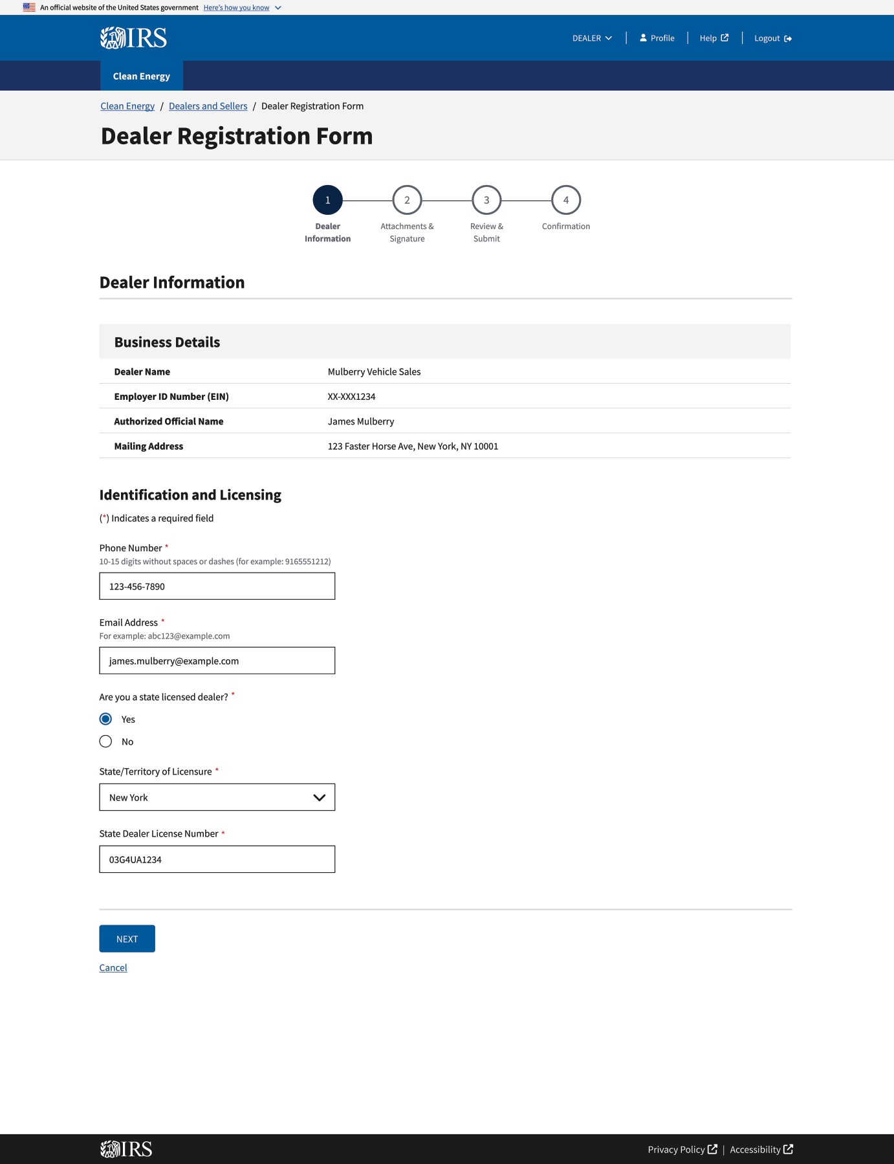
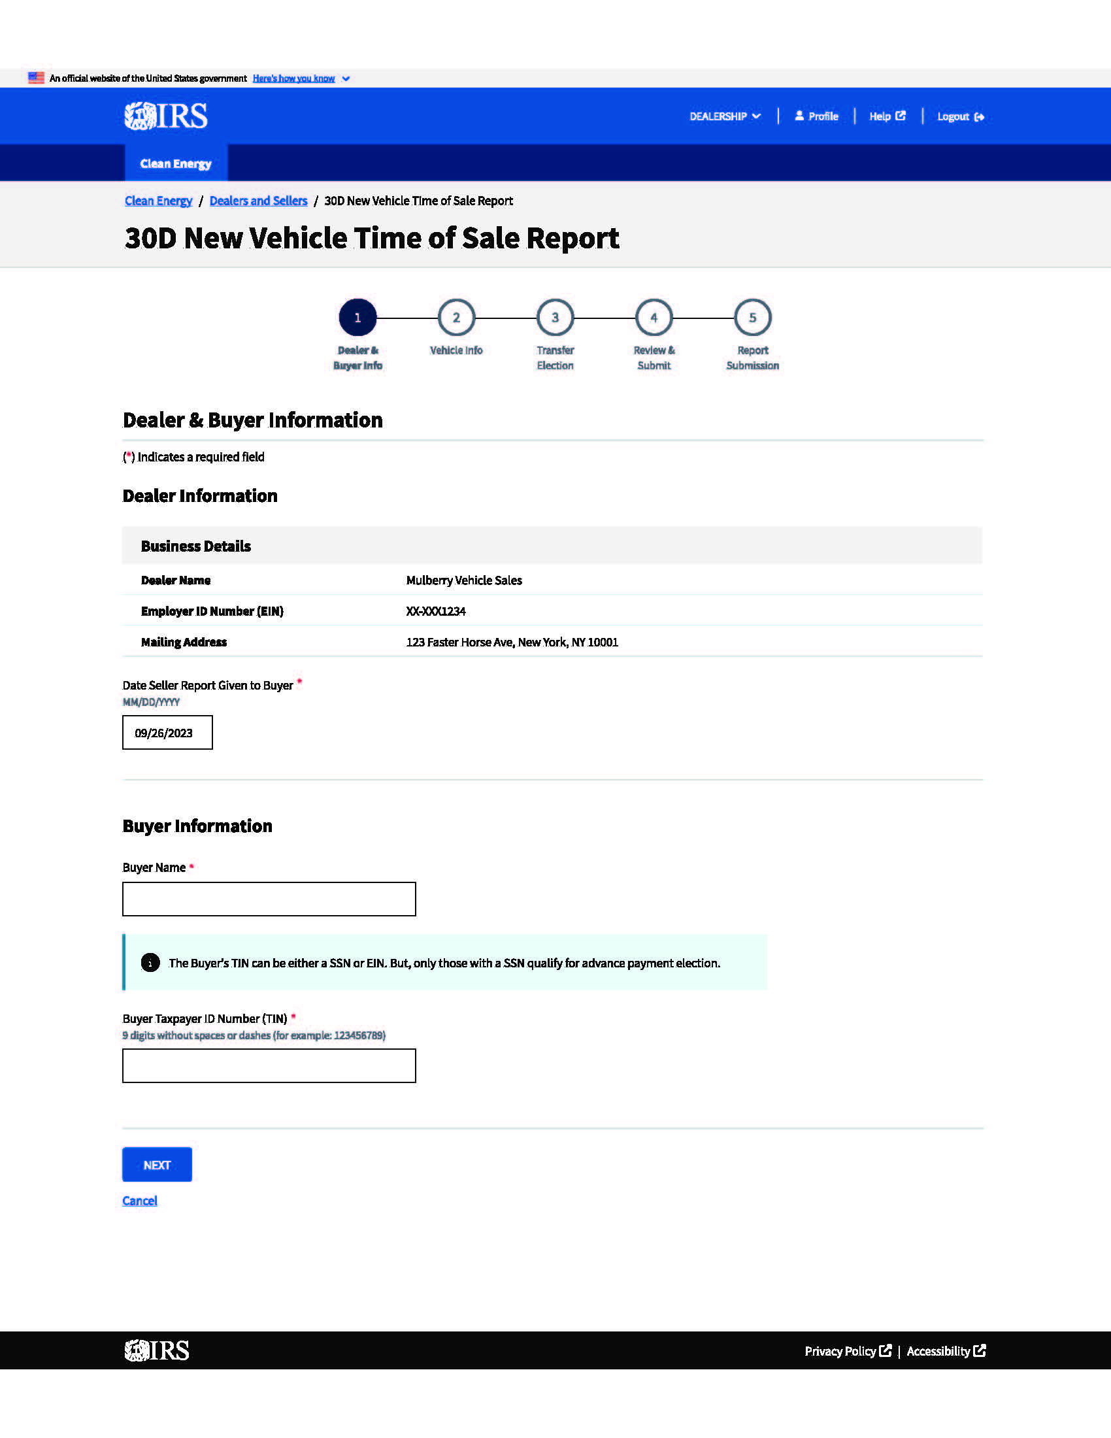
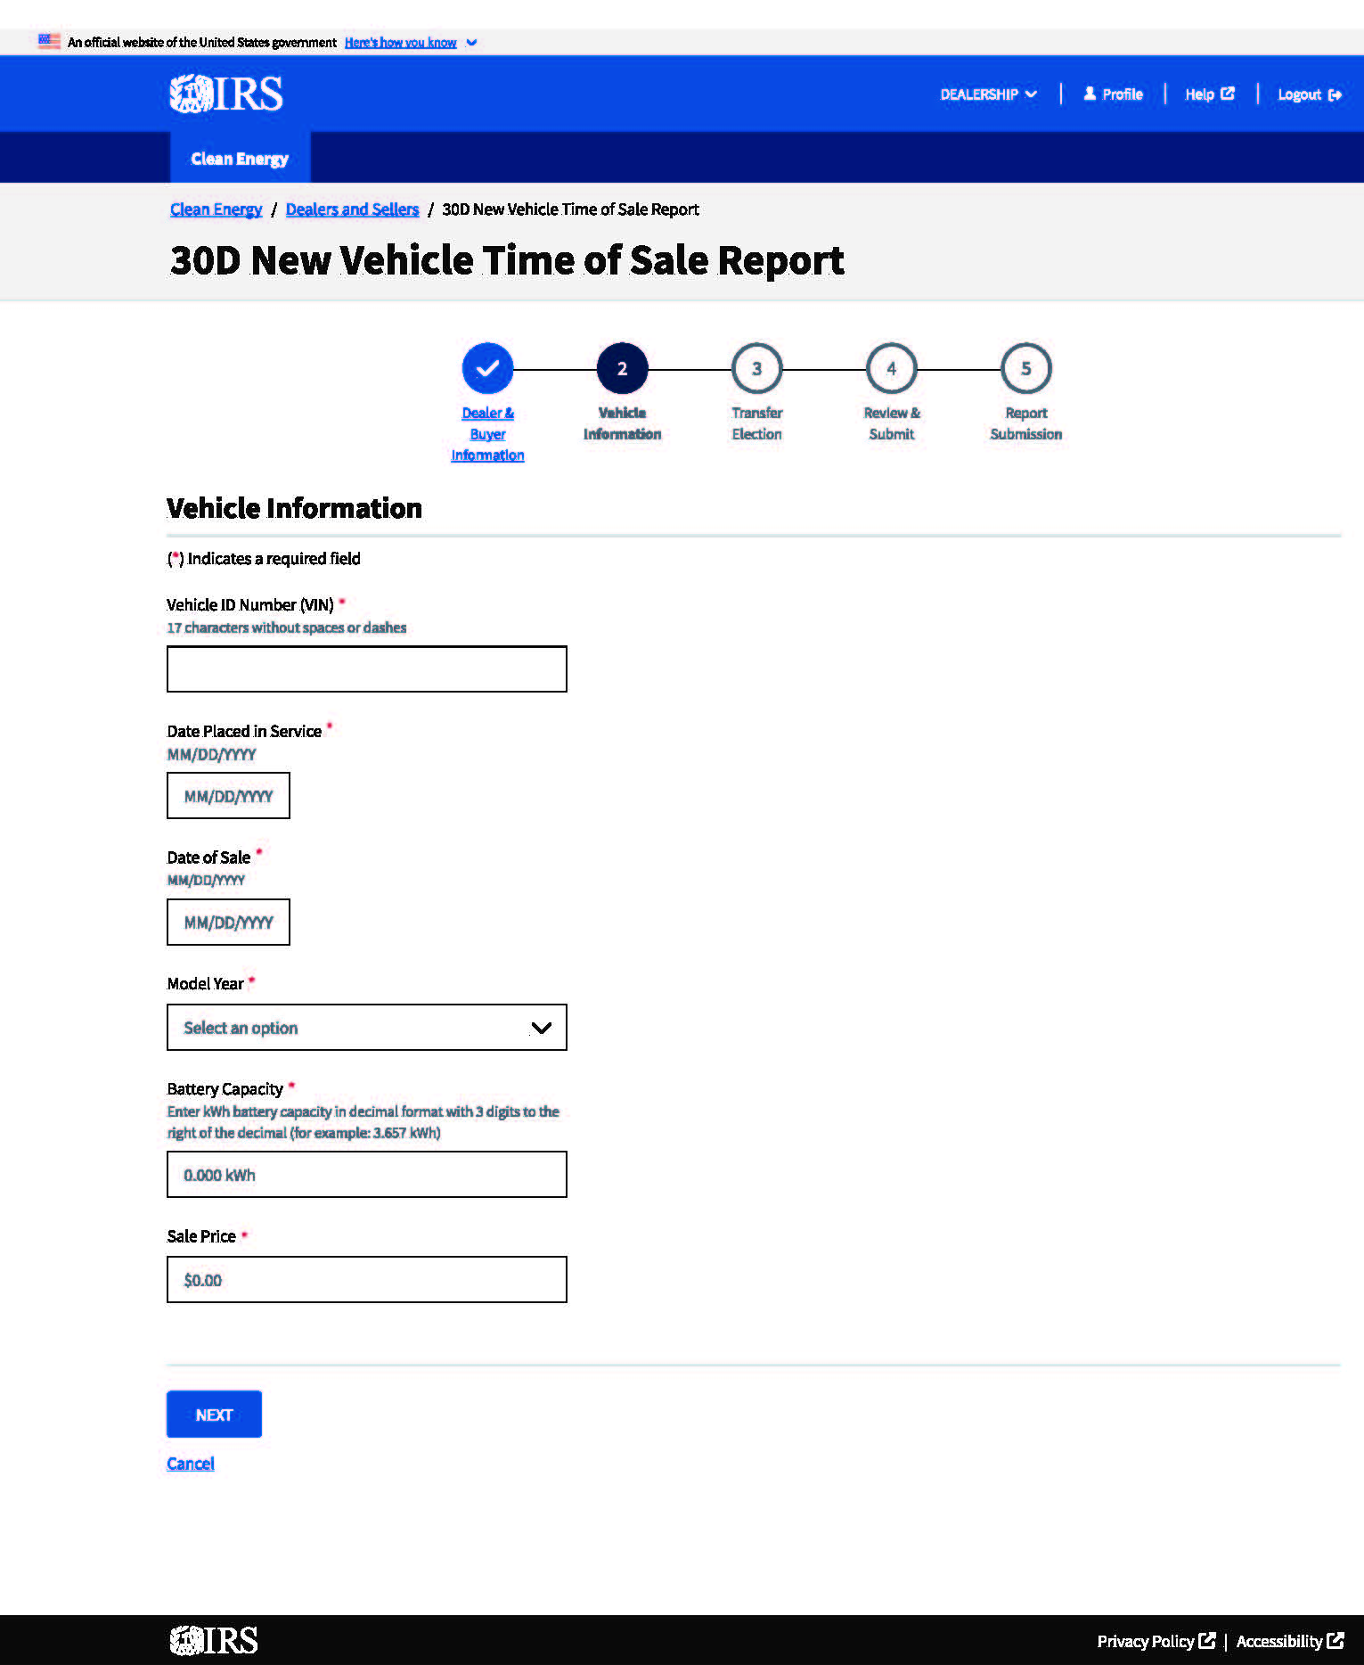
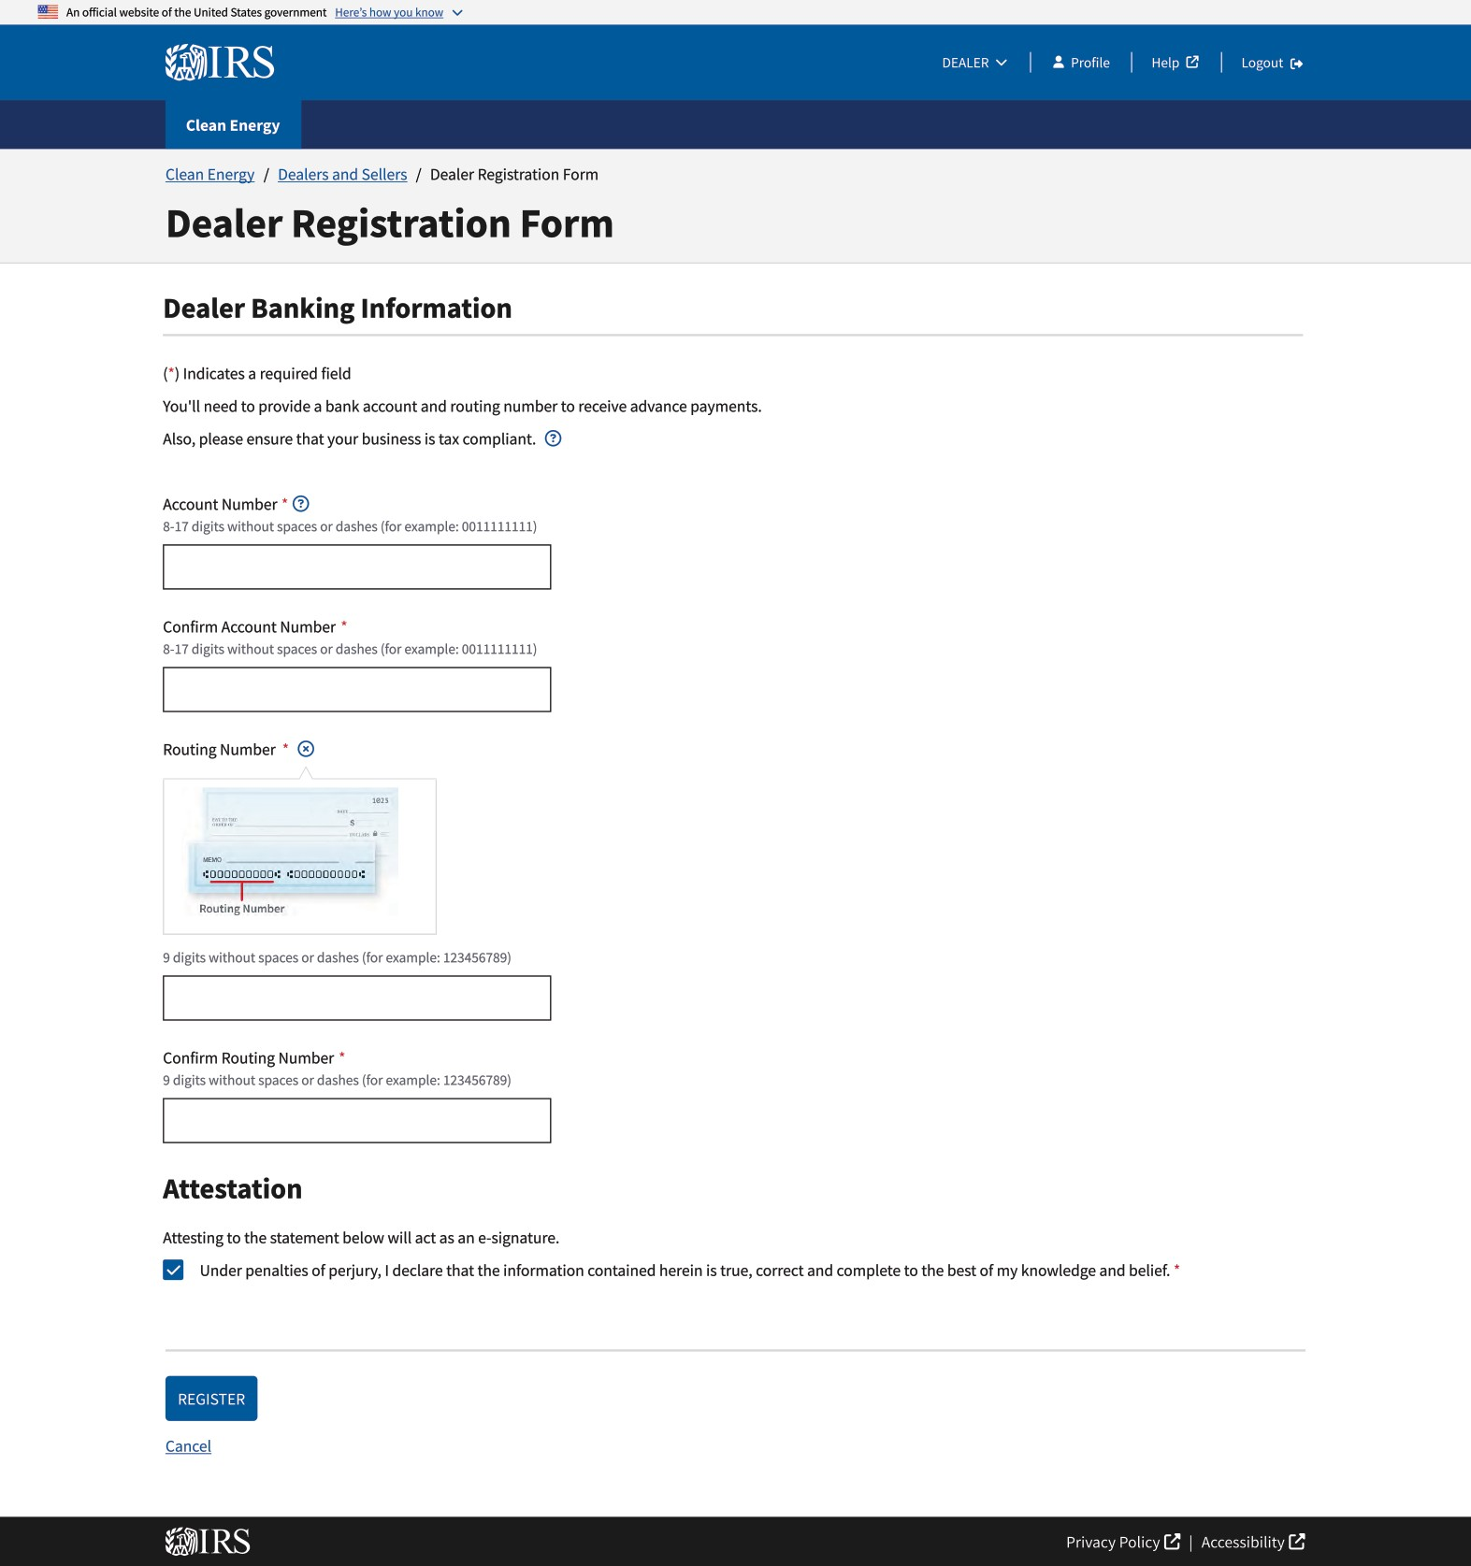
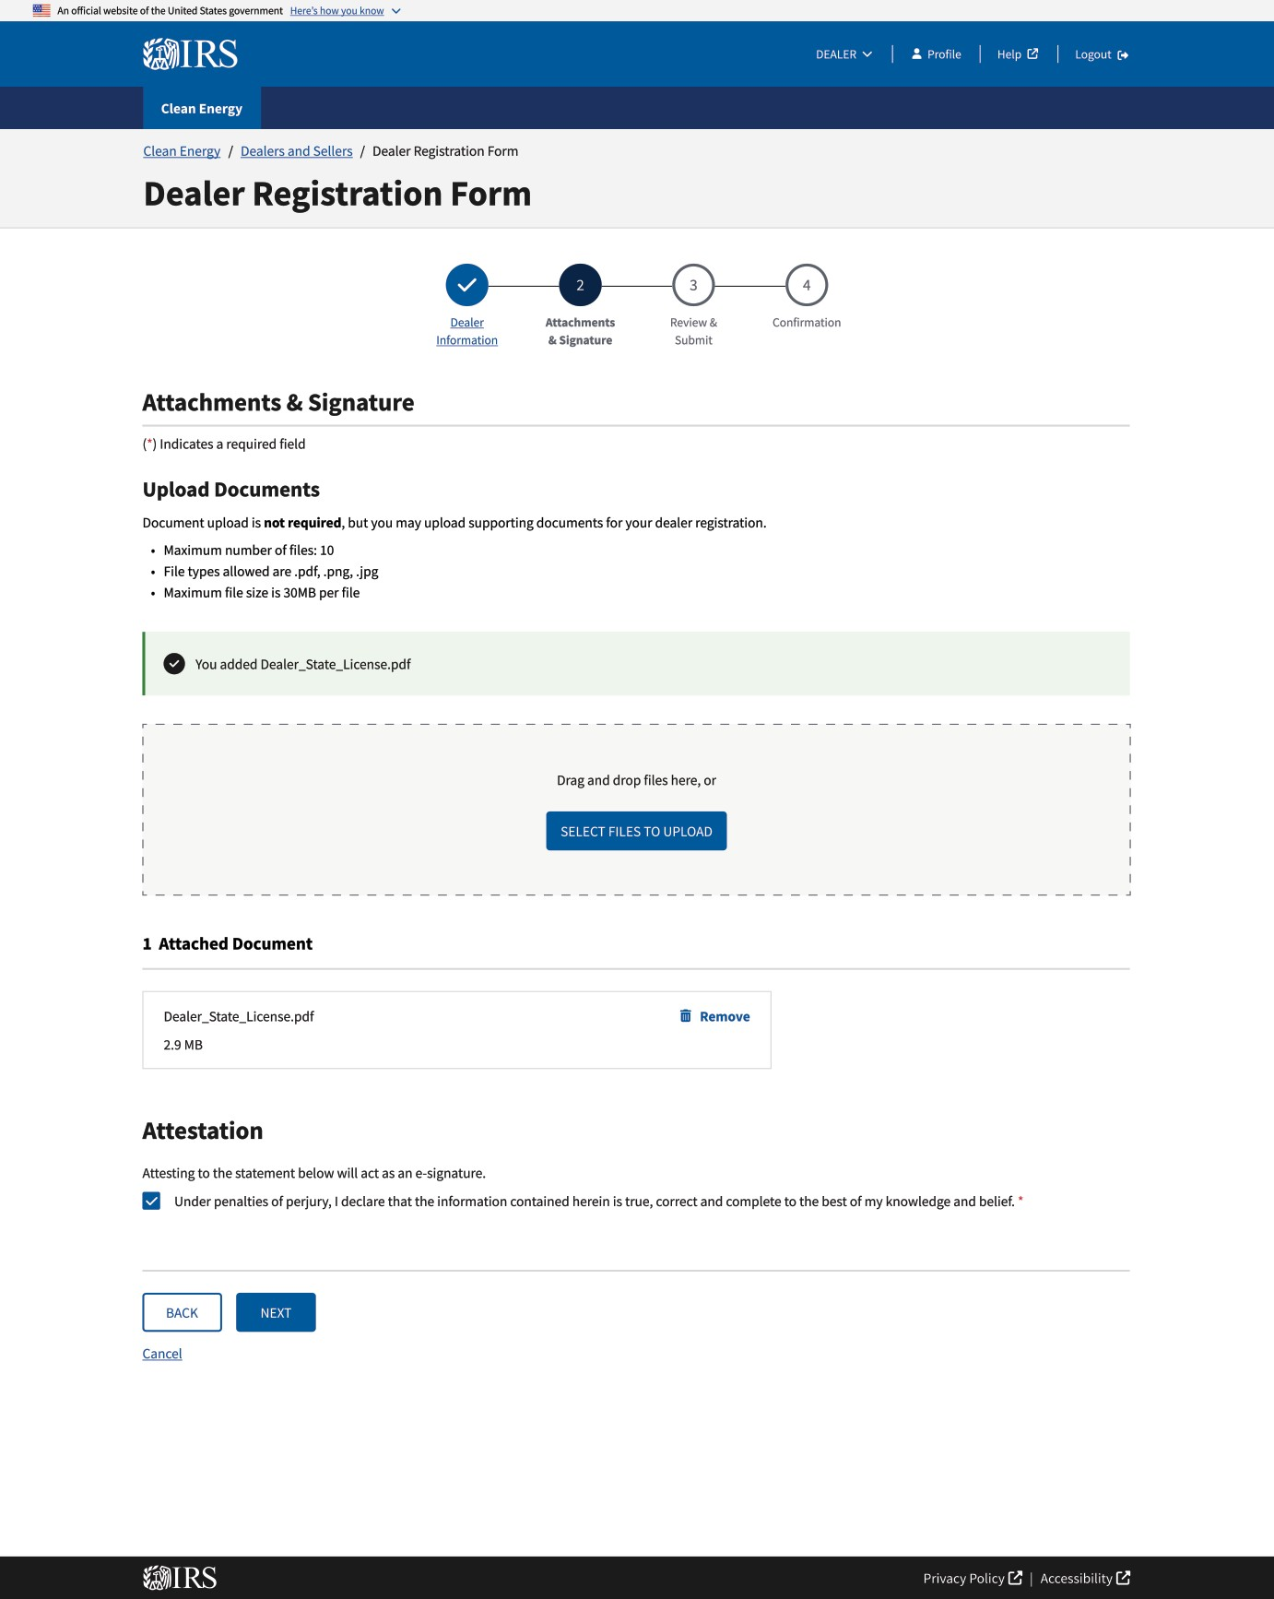
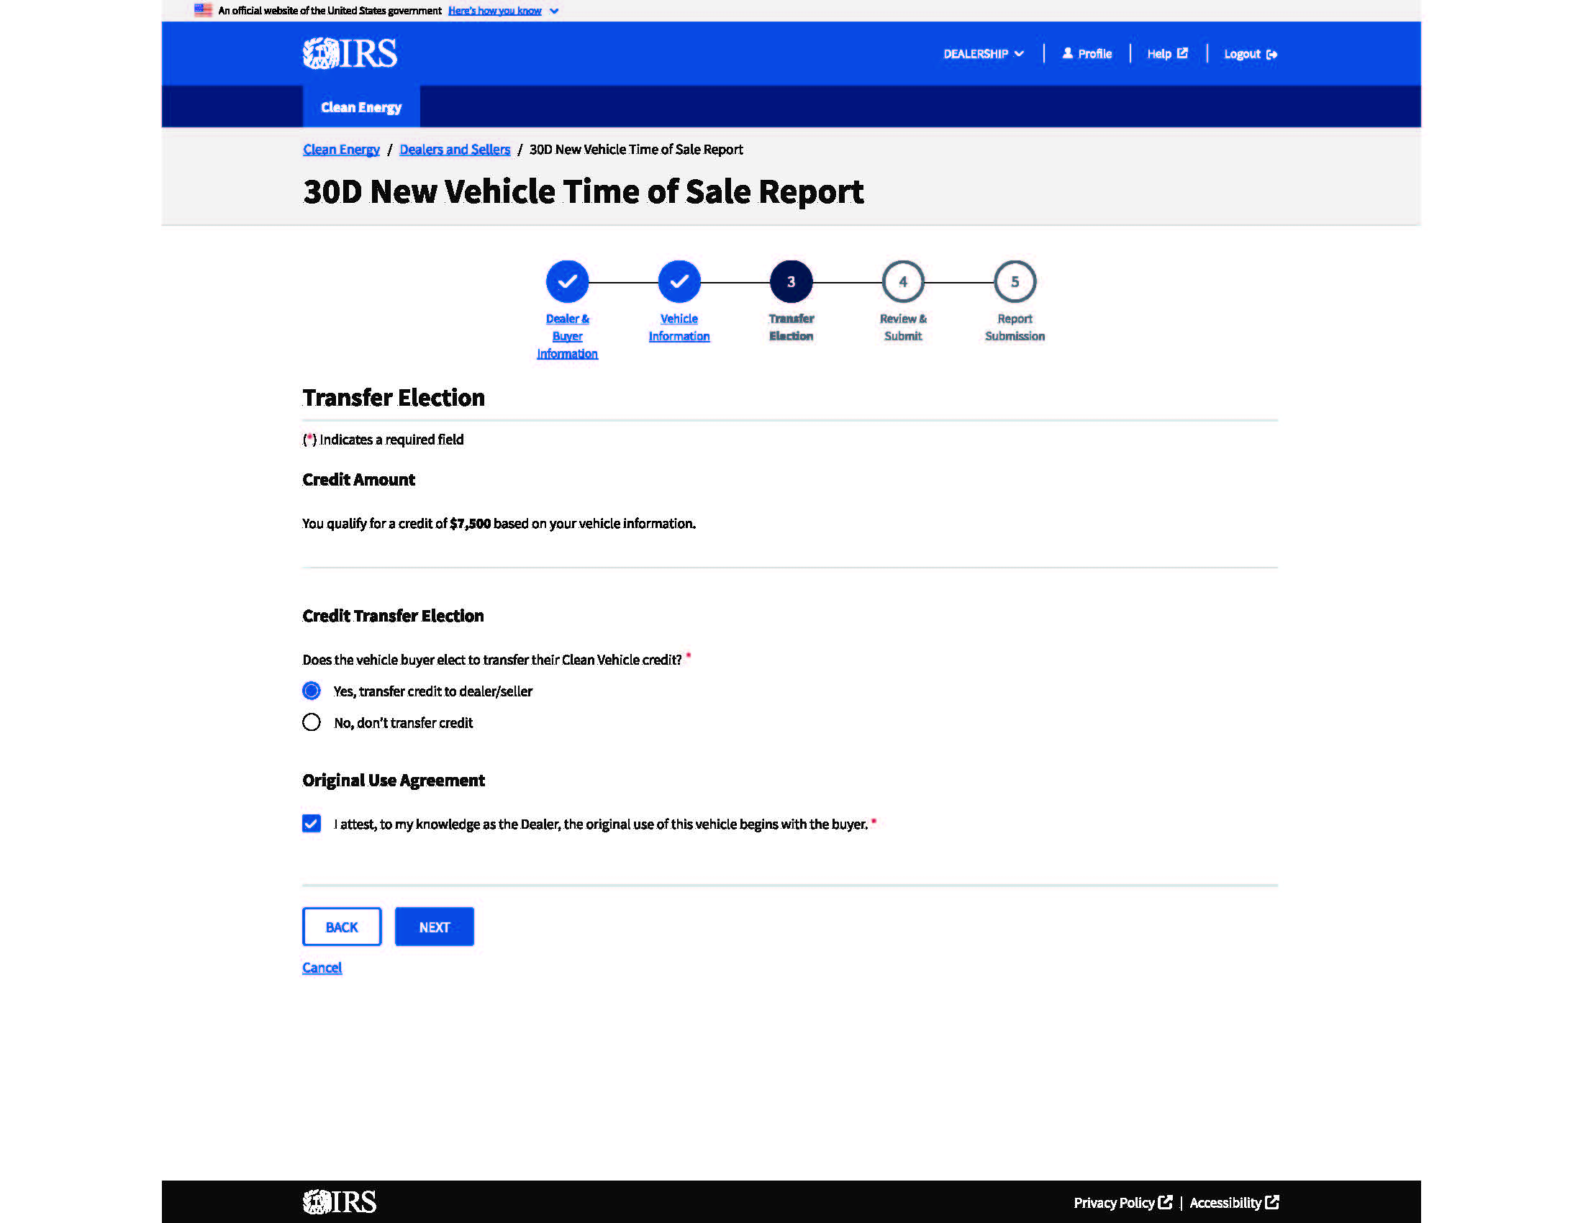
IRS Energy Credits Online Registration
Each Registration step in IRS Energy Credits Online is important:
Your Dealership Create an account so you can register as a dealer/seller in IRS ECO
Time of Sale Reporting Register for Time of Sale reporting so you can submit required reports
Advance Payments Register your dealer to receive advance payments for transferred clean vehicle credits
We will review each of these steps

Slide 14
IRS Energy Credits Online Benefits
Confirmation that a specific VIN is eligible for the credit and the amount of the credit*
Real-time IRS approval and rejection of time of sale reports
Automatically prepares a time of sale report for dealer to provide the buyer
Fast and secure electronic-payment delivery
No additional end-of-year time of sale reporting for 2024 onwards
Multiple users; control who can represent your organization
* IRS Energy Credits Online does not confirm the buyer’s eligibility. For previously owned clean vehicles, the dealer will need to review the vehicle history report and attest to the vehicle’s eligibility as a first qualified sale. IRS ECO will confirm the max allowable credit for a new clean vehicle. For used clean vehicles, the amount of the credit is dependent on the sales price.

Slide 15
Dealer Registration
Dealers and sellers must register with IRS ECO for their buyers to claim clean vehicle credits.
More than 13,000 dealers have registered.
Registration will include:
Contact information
Licensing information
Associated documents
Required attestations
Refer to the IRS User Guide for more detail: https://www.irs.gov/pub/irs-pdf/p5867a.pdf.
Note: All data in the screens displayed in this presentation is notional. The example is illustrative and does not represent a real entity.

Slide 16
Advance Payment Registration
Registration for advance payments allows the dealer to request an advance payment for transferred credits when submitting a time-of-sale report.
Most registered dealers have registered for advance payments.
Requirements:
Only licensed dealers are eligible for advance payments.
The dealership must be in tax compliance.
Banking information is required for advance payments. This should be the appropriate bank account for the dealership. Note: Once bank account information is entered it cannot be changed at this time.
There is a 15-day minimum waiting period after registration before an advance payment request can be submitted.
Dealers that have not been approved for advance payment should not reduce the purchase price of a vehicle in anticipation of later submitting an advance payment request with respect to a clean vehicle sale.

Slide 17
Time of Sale Reporting - Real-time Confirmation
IRS Energy Credits Online will accept or reject time-of-sale reports in real time.
An accepted submission means a qualified manufacturer has submitted the VIN listed in this report to the IRS as an eligible vehicle.
Dealers and sellers must provide a copy of this time-of-sale report to buyers.
Buyers will need the information on the time-of-sale report to claim or reconcile a Clean Vehicle Credit on the income tax return for the year the vehicle is placed in service.
The buyer that can claim the clean vehicle tax credit must use their legal name listed with the Social Security Administration.
The IRS is promptly paying dealers once a time-of-sale report with an advance payment request is submitted and accepted by the IRS (deposits typically occur within 48-72 hours after the expiration of the 48-hour void period for a successful request)

Slide 18
Agenda
Disclaimers
Clean Vehicle Tax Credit Background and Guidance
Registering with IRS Energy Credits Online
Time-of-Sale Submissions
What’s Ahead: IRS ECO Updates
Resources

Slide 19
Frequently Asked Questions on IRS.gov
Q: Are dealers liable to repay the advance payment if the purchaser exceeds the applicable income limits? Are dealers required to verify a purchaser’s income in order to receive an advance payment?
A: Dealers are not required to verify a purchaser’s income for a credit transfer or advance payment and are not required to repay the advance payment if the purchaser exceeds the income limits. Dealers are required to disclose information about the applicable income limits to the purchaser, who must attest that he or she expects to qualify for the credit. To assist dealers with their disclosure obligations, the IRS published a sample disclosure form.
Q: What if a buyer has insufficient tax liability to fully use a transferred credit?
A: The amount of the credit that the electing taxpayer elects to transfer to the eligible entity may exceed the electing taxpayer’s regular tax liability for the taxable year in which the sale occurs, and the excess, if any, is not subject to recapture from the dealer or the buyer.
Q: What is the first transfer rule for purposes of being a qualified sale of a previously owned clean vehicle?
A: It is the first transfer of the vehicle after Aug. 16, 2022, of the Previously Owned Clean Vehicle Credit other than to the person who was the original user of the vehicle. The original user’s sale of the vehicle to a dealer or a subsequent dealer does not negate the vehicle’s eligibility for the credit under the first transfer rule. As described in Topic J FAQ 2, sellers will review vehicle history reports when making attestations regarding the vehicle’s eligibility and submitting seller reports.
Q: If my dealership runs into difficulty at any point in the registration process, who should I contact?
A: Please contact IRS.Clean.Vehicles.Dealer.Info@IRS.gov with questions.

Slide 20
Dealer Resources
Buyer Resources
IRS Time-of-Sale Reporting User Guide: For step-by-step information and screenshots of the time-of-sale reporting process in IRS ECO.
IRS Dealer Registration User Guide: For step-by-step information and screenshots of the dealer registration and advance payment registration processes in IRS ECO.
IRS ECO Dealer Overview: Overview of IRS ECO process.
Transfer of Credit Information and Disclosures: Provides information about information and disclosures dealers must provide buyers.
Clean Vehicle Credit Seller or Dealer Requirements and FAQs: For more information on general dealer requirements and policies.
Dealers can sign-up to receive updates via an IRS e-News Subscriptions here. Select “e-news for business” and sign-up for e-news for clean vehicle industry.
Dealers can reach out to the IRS clean vehicles dealer email for help with specific issue: irs.clean.vehicles.dealer.info@irs.gov
New Clean Vehicle Tax Credit Checklist and Used Clean Vehicle Tax Credit Checklist: Outlines requirements for buyers seeking to purchase a clean vehicle and qualify for the New or Previously Owned Clean Vehicle Tax Credit.
Search for Eligible Vehicles on Fueleconomy.gov: For information regarding vehicle eligibility, including search function
IRS.gov/CleanVehicles: IRS Website containing general information about the Clean Vehicle Tax Credits.
Example Time of Sale Reports (New, Used): What to expect to receive from the dealer when purchasing a clean vehicle and claiming a credit.

Slide 21
Appendix

Slide 22
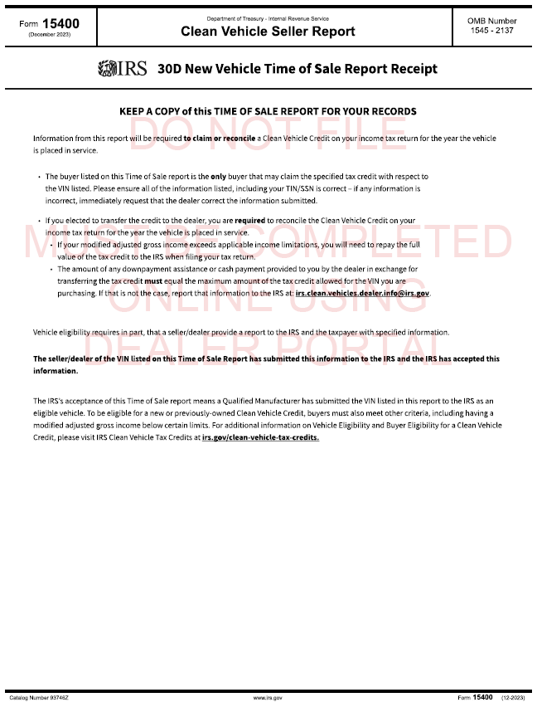
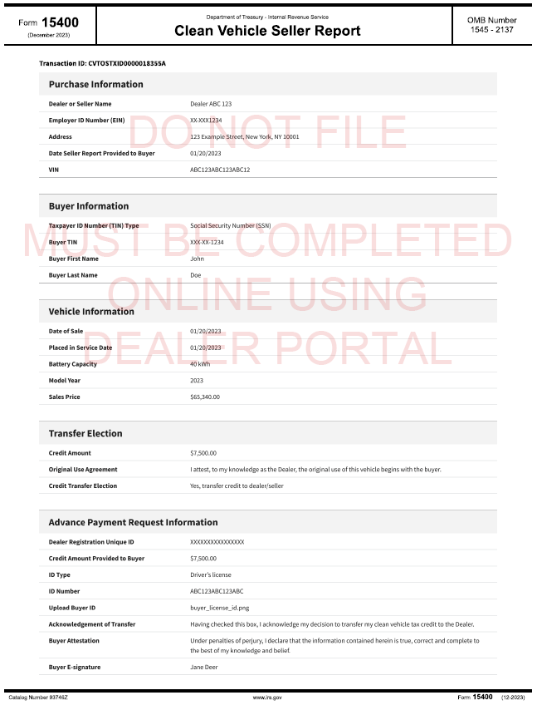
Clean Vehicle Time of Sale Report Sample
Note: All data in the screens displayed in this presentation is notional. The example is illustrative and does not represent a real entity.

