Slide 1
PWA ‘How To’ Session Inflation Reduction Act: Prevailing Wage and Registered Apprenticeship Requirements
Summer 2024

Slide 2
Agenda
Introduction and disclaimers
Overview of IRA Prevailing Wage and Registered Apprenticeship Requirements
Prevailing Wage and Registered Apprenticeship Resources
Compliance
Conclusion

Slide 3
Ground Rules: Disclaimers
This deck provides an overview of certain Inflation Reduction Act tax provisions for general informational purposes only and is not itself tax guidance.
The content in this presentation is based on final regulations and other tax information on IRS.gov.
This deck relies on simplifications and generalizations to convey high-level points about Inflation Reduction Act tax provisions. Please refer to guidance issued by the IRS for detailed information on the rules associated with Inflation Reduction Act tax provisions.

Slide 4
The Significance of IRA Prevailing Wage and Apprenticeship Requirements
“President Biden’s Inflation Reduction Act has driven an investment boom while ensuring that workers building the clean energy economy benefit from good pay and new opportunities to get ahead. Treasury’s final rules ensure we have skilled workers ready to take advantage of the jobs being created by these historic investments.”
– Janet L. Yellen, Secretary of the Treasury

Slide 5
Agenda
Introduction and disclaimers
Overview of IRA Prevailing Wage and Registered Apprenticeship Requirements
Prevailing Wage and Registered Apprenticeship Resources
Compliance
Conclusion

Slide 6
Overview of IRA Prevailing Wage and Apprenticeship Requirements
The Inflation Reduction Act provides increased tax benefits for a range of clean energy projects to taxpayers that ensure Davis-Bacon Act prevailing wages are paid to workers on such projects and that registered apprentices are utilized.
The Inflation Reduction Act amended several clean energy tax incentives in which taxpayers can increase the base amounts of the credits by 5x if certain prevailing wage and registered apprenticeship (PWA) requirements are met.
This provision has been put into effect for qualifying facilities, projects, property, or equipment for which construction began on or after January 29, 2023.
Taxpayers must keep records sufficient to establish, among other things, the amount of any credit or deduction claimed and to establish compliance with both the prevailing wage and apprenticeship requirements.

Slide 7
IRA Prevailing Wage Requirements
What is prevailing wage?
The combination of the basic hourly wage rate and any bona fide fringe benefits.
Paid to workers in a specific labor classification
For the type of construction being performed
In the geographic area where construction is performed
As determined by the Secretary of Labor
To meet the prevailing wage requirements, any laborers and mechanics employed by the taxpayer (or any contractor or subcontractor) must be paid wages at rates not less than the prevailing rates based on the geographic area for the type of construction and the type of work performed.
Local prevailing wage is determined in accordance with Department of Labor standards under the Davis-Bacon Act. More information is available at SAM.gov.

Slide 8
IRA Apprenticeship Requirements
What is a registered apprenticeship?
An industry-driven, high-quality career pathway where employers can develop and prepare their future workforce, and individuals can obtain paid work experience with a mentor, receive progressive wage increases, classroom instruction, and a portable, nationally-recognized credential.
Taxpayers (and their contractors and subcontractors) must employ qualified apprentices for work on qualified facilities during the construction phase, prior to the facility being placed in service. The rules generally require a certain number of apprentice hours based on the percentage of overall hours on a project.
Apprenticeship Rules:
Qualified apprentices must be from registered apprenticeship programs.
Minimum percentage of total labor hours by qualified apprentices (12.5% for projects beginning construction in 2023, 15% beginning construction in 2024).
Apprentice-to-journey worker ratios of DOL or the applicable State apprenticeship agency.
Each taxpayer, contractor, or subcontractor who employs 4 or more individuals to perform work on a qualified facility must employ one or more apprentices across the full range of work.

Slide 9
Statutory Exceptions to IRA Prevailing Wage and Apprenticeship Requirements
Taxpayers can generally receive the increased credit amount without being subject to PWA requirements if:
Construction of a facility began before January 29, 2023; OR
For the clean energy production and investment tax credits (45, 45Y, 48, and 48E), the facility has a maximum net output of less than 1 megawatt alternating current
1 megawatt exception also applies to thermal energy under 48 and energy storage technology under 48E.

Slide 10
Penalties and Cure
If the prevailing wage or apprenticeship requirements were not met during any period of the construction, alteration, or repair of a facility, taxpayers may still be eligible to get the PWA increased credit amount by making correction and penalty payments.
Prevailing Wage Correction and Penalty Payments
Taxpayers who employed laborers or mechanics at wages below prevailing rates must pay the difference between what they paid and the prevailing wage to the laborers and mechanics, plus interest.
They must also pay a penalty to the IRS of $5,000 per worker who was paid wages below the prevailing rates.
If the IRS determines that the failure is due to intentional disregard of the requirements, taxpayers must pay the workers three times the difference between what they paid and the prevailing wage, and they must pay an enhanced penalty to the IRS of $10,000 per worker who was paid wages below the prevailing rates.
Apprenticeships Cure
To cure a failure to meet the apprenticeship requirements, a taxpayer must pay a penalty of $50 multiplied by the total labor hours for which the apprenticeship requirements were not met. Penalties apply for failure to satisfy the labor hours requirement and the participation requirement.
The amount of the penalty with respect to the apprenticeship requirements is also increased to $500 per labor hour if the IRS determines the failure was due to intentional disregard.

Slide 11
IRA Prevailing Wage and Registered Apprenticeship Increased Credit
From Day 1 – Prevailing Wage
Pay laborers and mechanics employed in construction, alteration, or repair no less than applicable prevailing wage rates
Wage Determinations
From Day 1 - Apprenticeships
Employ apprentices from registered apprenticeship programs for a certain number of labor hours
Submit written request for registered apprentices no later than 45 days before the qualified apprentices are requested to start work
Other examples that would demonstrate compliance include identifying information or laborers, mechanics, and apprentices, labor classifications and the applicable wage determination, hourly rate(s) of wages paid for each applicable labor classification, agreements with registered apprenticeship programs, etc.
Ongoing Compliance
Meet recordkeeping requirements
Contemporaneous monitoring through tax filing date
Address any needed penalties and cures
Taxpayers who fail to meet the prevailing wage and apprenticeship requirements may still be able to claim the increased tax incentive amounts by making certain correction and penalty payments
Tax return filed
Receive credit
Increase the base amounts of the credit by 5 times in the calendar year that the facility being claimed was placed in service
Labor classifications
Must maintain and preserve payroll records related to the employment of laborers, mechanics, an apprentices (including records of any contractor/subcontractor)
Calculate labor hours and meet participation requirements
Apprentice-to-journeyworker ratio requirements apply daily

Slide 12
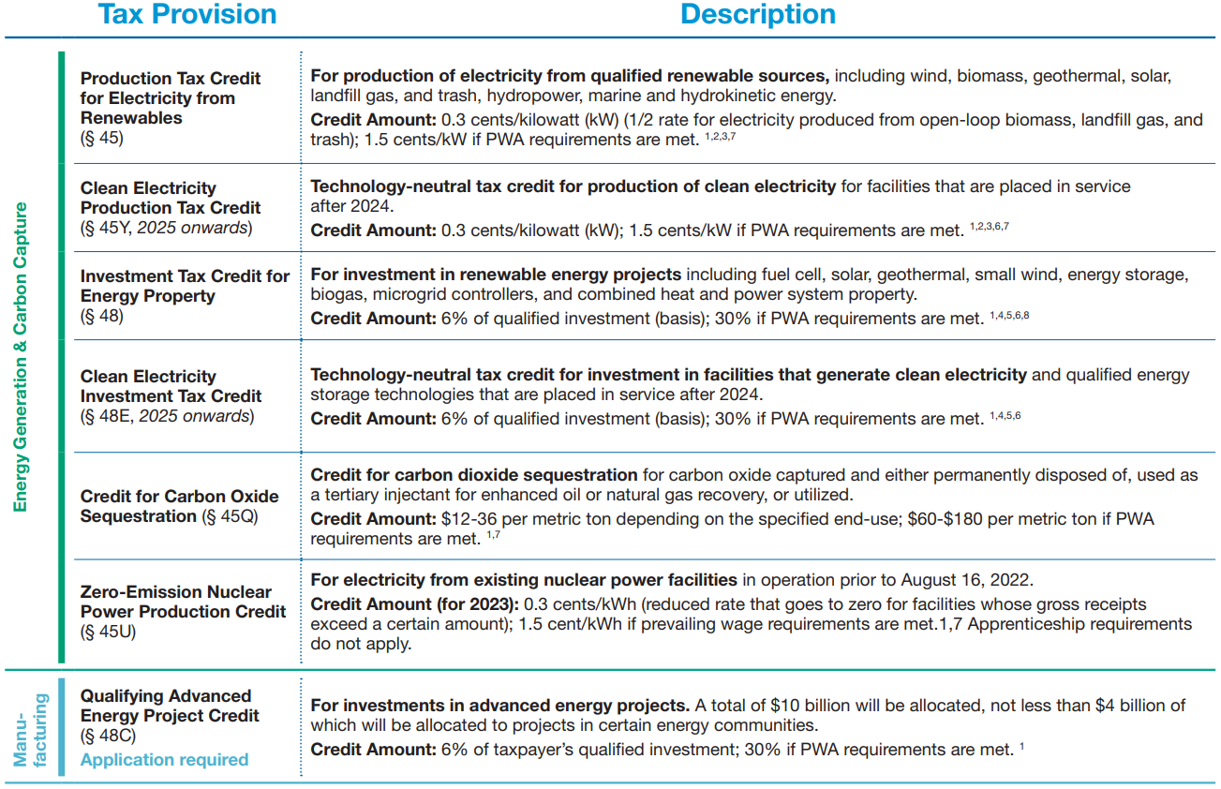
Tax Benefits Eligible for IRA Prevailing Wage and Apprenticeship Increase

Slide 13
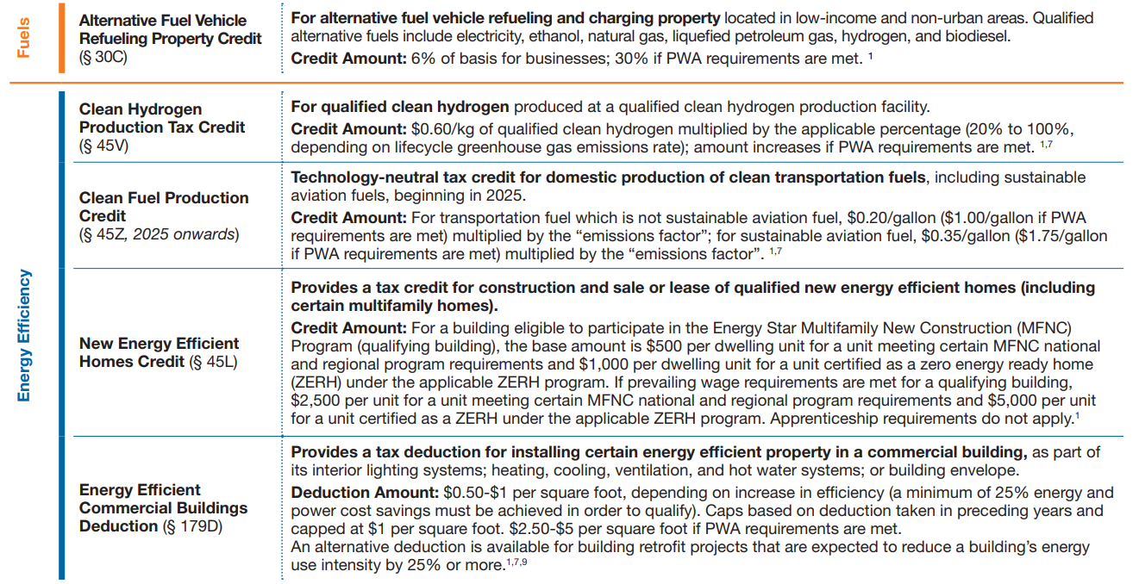
Tax Benefits Eligible for IRA Prevailing Wage and Apprenticeship Increase

Slide 14
Agenda
Introduction and disclaimers
Overview of IRA Prevailing Wage and Registered Apprenticeship Requirements
Prevailing Wage and Registered Apprenticeship Resources
Compliance
Conclusion

Slide 15
Where to find Prevailing Wage Rates ​
Prevailing wage rates are found in Wage Determinations (WD).
WDs are issued by the U.S. Department of Labor’s Wage and Hour Division
Published on www.sam.gov
There are four types of construction for which wage determinations are published: ​​
Heavy
Highway
Building ​
Residential
Notes:
Natalie Collins
WHD Remarks

Slide 16
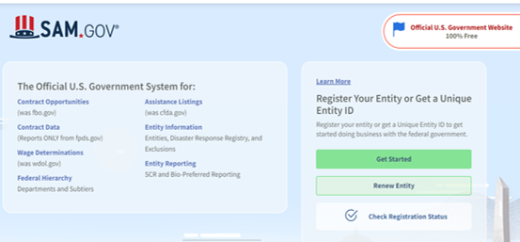
How to Find a Wage Determination ​
Go to sam.gov​
Select Wage Determinations ​
Select Public Building or Works ​
Select the applicable State, County, and Construction Type​
Select the applicable Wage Determination on www.sam.gov
Notes:
Meghan Vesper
WHD Remarks
Wage determinations are published by the Wage and Hour Division of the US Department of Labor on www.sam.gov and are available to the public. ​
Once on sam.gov, there are a few pieces of information that are critical to ensuring a taxpayer has identified the correct wage determination to use for its project., those things being the state, county and construction type.
Go to sam.gov​
Select Wage Determinations ​
Select Public Building or Works ​
Select the applicable State, County, and Construction Type​
Select the applicable Wage Determination on www.sam.gov.
​

Slide 17
Assistance Finding a Wage Determination​
For more information on finding the applicable Wage Determination, please consult WHD’s “Guide to Finding Your Wage Determination on sam.gov” at https://www.dol.gov/agencies/whd/IRA
Notes:
Meghan Vesper
WHD Remarks
If you need assistance finding an applicable wage determination, please consult WHD’s guide to finding your wage determination, which can be found at our Inflation Reduction Act landing page under "other resources." The web address is https://www.dol.gov/agencies/whd/IRA

Slide 18
Utilizing Appropriate Labor Classifications
Wage determinations include labor classifications based generally on trades or occupations.​
A taxpayer should identify the labor classifications needed to perform work on the facility and compare them to the labor classifications on the wage determination.
An additional labor classification should be requested only when the work needed for a project is not performed by a labor classification already listed on the applicable wage determination.
If a wage determination does not include a needed labor classification, an additional classification may be requested at IRAprevailingwage@dol.gov​
Notes:
Meghan Vesper
WHD Remarks
Labor classifications, not individual tasks, are listed on wage determinations. These labor classifications are based generally on trades or occupations. It is, therefore, vital to understand the scope of the project and the labor classifications that are necessary for the work to be performed at or on the facility.​ A tax payer should identify the labor classifications needed to perform work on the facility and compare them to the labor classifications on the wage determination.
​
In limited circumstances, when there is no appropriate labor classification on the applicable general wage determination, WHD may add a new class of laborer or mechanic and a wage rate. But an additional labor classification and wage rate may only be granted when certain criteria are met, which we will discuss on a later slide. In short, an additional labor classification should only be requested when the work needed for a project is not performed by a labor classification that is already listed on the applicable wage determination.

Slide 19
Requests for Additional Labor Classifications for IRA
Where the work needed for a project is not performed by a labor classification already listed on the applicable wage determination, an additional labor classification can be requested.
A request for prevailing wage rates for additional classifications should be made:
Where there is a contract for construction: any time after a contract for the construction, alteration, or repair of a facility has been executed between the taxpayer and a contractor OR no more than 90 days before the taxpayer expects to execute the primary contract for the construction, alteration, or repair of the facility.
In the absence of a contract: no more than 90 days before construction, alteration, or repair of the facility starts.

Slide 20
Requests for Supplemental Wage Determinations for IRA
In limited circumstances, there may not be a general wage determination for a certain geographic area or for the specified type of construction applicable to the construction, alteration or repair of a qualified facility.
In such circumstances, the taxpayer, contractor, or subcontractor may request a supplemental wage determination applicable to the construction, alteration, or repair of that facility by emailing IRAprevailingwage@dol.gov
Where there is a contract for construction: no more than 90 days before the taxpayer (or the taxpayer’s designee, assignee, or agent) expects to execute the contract for the construction, alteration, or repair of the facility
In the absence of a contract: requests no more than 90 days before construction, alteration, or repair of the facility starts.

Slide 21
Wage and Hour Division Support & Assistance ​
WHD can provide technical and compliance assistance
Additional Resources: ​
DOL IRA landing page: https://www.dol.gov/general/inflation-reduction-act-tax-credit
WHD IRA landing page: https://www.dol.gov/agencies/whd/IRA
Wage Determinations available at www.sam.gov
Request IRA prevailing wage information: IRAprevailingwage@dol.gov
Clean Energy Powered by the IRA
Notes:
Meghan Vesper
WHD Remarks

Slide 22
Apprenticeship & IRA Resources for business taxpayers and stakeholders

Slide 23
REGISTERED APPRENTICESHIP HAS A PROVEN TRACK RECORD OF PRODUCING STRONG RESULTS FOR EMPLOYERS AND WORKERS
IMPRESSIVE INDIVIDUAL – EMPLOYEE – PUBLIC RETURN ON INVESTMENT
44.3%
Employer return on investment in Registered Apprenticeship
93%
Of those that complete their apprenticeship retain employment after completion.
$28
In benefits for every $1 invested by the government
$77K
$300K+
Completers earn per year on average
Apprentices’ lifetime earning average
Data provided by www.apprenticeship.gov
Notes:
Why Apprenticeships?
The staggering unemployment brought on by the COVID pandemic in 2020 has resulted in talent shortages with the current workforce, and created national security issues in industries such as Cybersecurity, Transportation and Healthcare as companies scramble to fill positions to meet current demands.
Furthermore, the pandemic exacerbated existing structural weaknesses in both domestic and international supply chains, leading to shortages across a range of sectors and products, which have also threatened America’s economic and national security.
To address these current challenges, industry stakeholders are increasingly calling on DOL, specifically the Office of Apprenticeship (OA), for direct assistance on how to quickly meet the demand for a skilled workforce through Registered Apprenticeships (RAPs).
Because we know apprenticeship works, we want to increase its usage not only to grow our economy, but to help us provide equitable career pathways that advance the dignity of work and support this administration’s diversity and inclusion goals.
As we progress toward economic recovery and build America back better, we must expand opportunities in our workforce that are inclusive of individuals who have been historically underserved, marginalized, and adversely affected by persistent poverty and inequality.
With a 93% retention rate and proven return on investment, companies of all sizes like Microsoft, Amazon, CVS, IBM, Northrop Grumman, Hilton, Kaiser, Ford, GE, and so many more are creating apprenticeship programs to train students and adults for careers of today and tomorrow.

Slide 24
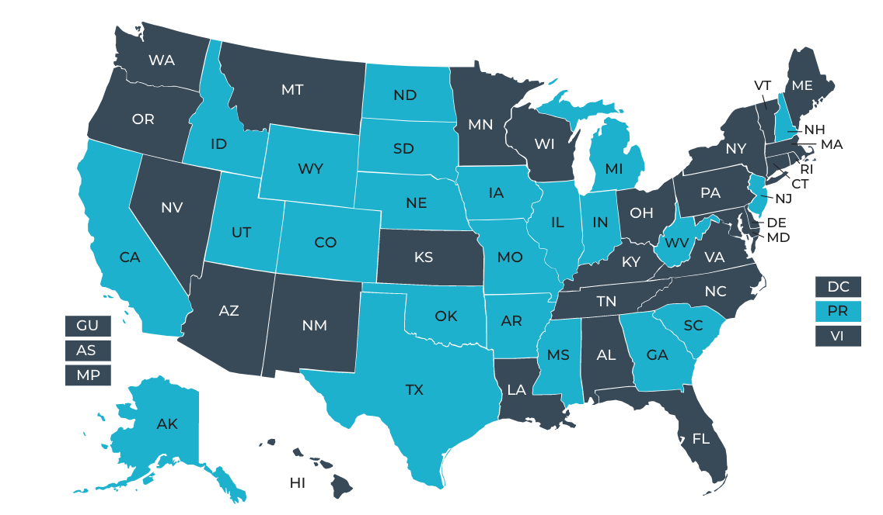
THE REGISTERED APPRENTICESHIP SYSTEM
Technical Assistance
Both OA and SAA staff have a significant role to play in supporting these organizations with technical assistance on joining, developing, or starting Registered Apprenticeship programs in the clean and renewable energy sector.
OA and SAA staff are uniquely positioned as key resources for assisting new employers to join existing group programs or in starting their own programs, assisting in providing referrals to existing programs, and answering questions about Registered Apprenticeship.
Notes:
What happens once companies have an apprenticeship program? How can they replicate across industry?
Apprenticeship programs are industry driven and belong to those employers and industry groups that sponsor the programs. Generally, we see programs grow in scale and expand beyond their initial occupations.
Industry partners can also come together and develop NPS to take their program across their entire organization or NGS to provide a framework for other employers, particularly those in their supply chain or part of their industry association.
They can also add additional employers to their programs if they are a sponsor

Slide 25
Pathways to Registered Apprenticeship Programs
Existing Registered Apprenticeship Program
A company can join an existing program
New RA Program
A company, group of companies, labor organization, NPO, etc. can sponsor a new program
DOL OA facilitates free services though intermediaries who can assist in establishing and having a program certified, and connect companies with other partners such as educators.
Someone must administer the program including activity reporting requirements
For more information, go to DOL’s Apprenticeship Homepage

Slide 26
Registered Apprenticeship Representatives
There are Registered Apprenticeship representatives serving in every state across the country to:
Provide technical assistance and support to Registered Apprenticeship Program sponsors and administrators
Assist organizations interested in developing and maintaining new programs
Partner with State Apprenticeship Agencies to assist organizations in getting their existing program approved (registered) by DOL;
Answer questions about the Registered Apprenticeship model;
Connect businesses to a network of partners including training providers;
Provide training in how to use recruitment tools available to Registered Programs and insight on recruitment sources;
Work with program sponsors to ensure that Registered Apprenticeship opportunities are inclusive and made available to diverse populations;
Compile and share marketing resources and tools;
Advise partners on available funding sources to support Registered Apprenticeship, including awarding and providing oversight for Registered Apprenticeship investments across the country.

Slide 27
Registered Apprenticeship Resources
Partner Finder Tool
Our Partner Finder Tool can connect you with the right partners to help you learn more about existing programs and how to design, develop, or enhance your program.
Occupation Finder Tool
Our Occupation Finder Tool can help you find occupations approved for use in a Registered Apprenticeship Program along with descriptions, alternative titles, and related occupations.
Standards Builder Tool
​​​​​​​Our Standards Builder Tool can help you quickly customize and register your program in a single centralized place.
Express Interest
Learn more about Registered Apprenticeships and how you can get started as an employer or a career seeker through our Express Interest portal
State Offices
​​​​​​​​​​​​​​State Apprenticeship offices are located across the nation to provide technical assistance and support to program sponsors, answer questions about the apprenticeship model, guide partners on each phase of developing a program, connect business to training providers, advise partners on available funding sources to support apprenticeships, and register eligible programs.
https://www.apprenticeship.gov/inflation-reduction-act-apprenticeship-resources
Notes:
We have provided links so that business taxpayers and system stakeholders can easily navigate to one of the many technical assistance tools available to help them locate partners, find occupations, develop program standards, learn more about how to become a sponsor, and locate state contacts.

Slide 28
Agenda
Introduction and disclaimers
Overview of IRA Prevailing Wage and Registered Apprenticeship Requirements
Prevailing Wage and Registered Apprenticeship Resources
Compliance
Conclusion

Slide 29
Compliance Overview
The statutory structure of the PWA requirements provides a very strong incentive to comply, as 80 percent of the value of the credit depends on compliance with these requirements.
Treasury is already seeing seeing credit buyers and insurers in the transferability and tax equity markets conducting thorough due diligence of these requirements, reflecting the significant amounts at stake and a belief in the effectiveness of the IRS audit process.
The IRS, which has a long history of effective tax enforcement, will ramp up its efforts and dedicate resources to ensure compliance and enforce the final rules.
Treasury and the IRS will also be involved in an ongoing collaboration with the Department of Labor (DOL) to ensure that we are leveraging the expertise of both agencies for IRS enforcement.
The final rules build on the statute with incentives for taxpayers to undertake additional activities that will support compliance, including providing adequate notice to workers and including flow-down provisions in their contracts.

Slide 30
Compliance: PWA vs. Davis-Bacon Act (DBA)
Areas of alignment:
Workers can report suspected violations. In the tax system, anyone can refer information of suspected violations of tax law to the IRS by using the Form 3949-A. However, due to taxpayer privacy laws, the IRS cannot communicate with external parties about the results of a complaint or the status of an investigation.
PWA requirements and DBA use same prevailing wage determinations, key definitions, and worker classifications.
Rules apply to all contractors and subcontractors.
Taxpayers can reduce risk of intentional disregard penalties for PWA by adopting some additional DBA practices, such as providing notice to workers of prevailing wages (e.g., notice at the site of work) and including flow-down provisions in contracts with contractors and subcontractors.

Slide 31
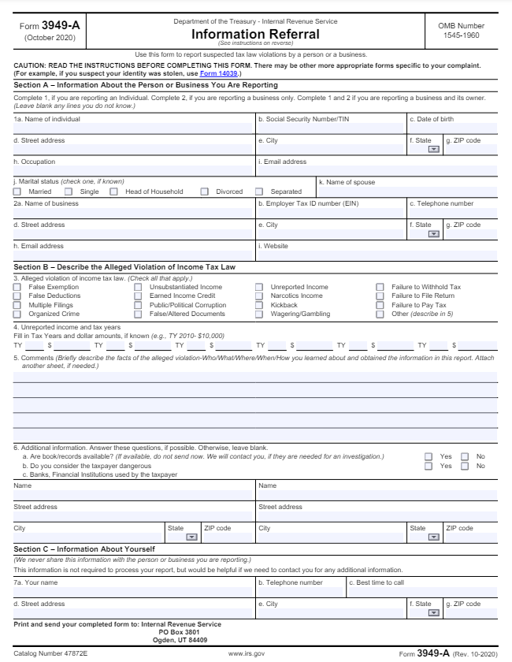
Compliance: Form 3949-A
If you suspect that PWA increased tax credits are being claimed for a project that isn’t meeting these requirements, you can report the suspected tax violation to the IRS using Form 3949-A, Information Referral www.irs.gov/forms-pubs/about-form-3949-a
To complete the form, visit: Form 3949-A. Indicate “PWA” in the ”Comments” field, and provide as much specific information as possible, including the address of the job site at which the construction took place

Slide 32
Compliance: PWA vs. Davis-Bacon Act (DBA)
Areas of difference:
Timing: IRS cannot make determinations of eligibility for credit until a return claiming a credit is filed; IRS then conducts audits and requests records as appropriate. If a taxpayer ultimately claims the increased PWA credit, the IRS considers all relevant information on any applicable audit.
Primary compliance mechanisms:
DBA requirements are enforced by the DOL under its regulations and requires the submission of weekly certified payrolls and DOL will investigate compliance at the time the project is being constructed.
Tax enforcement is primarily through audits after filing. In an audit, the IRS can access employer records, conduct site visits and interviews, and request any additional relevant information as needed.

Slide 33
Agenda
Introduction and disclaimers
Overview of IRA Prevailing Wage and Registered Apprenticeship Requirements
Prevailing Wage and Registered Apprenticeship Resources
Compliance
Conclusion

Slide 34
Closing
Resources
IRS general IRA landing page: IRS.gov/CleanEnergy
IRS IRA PWA page: IRS.gov/PWA
DOL IRA PWA page: DOL.gov/agencies/whd/IRA
DOL IRA apprenticeship page: Apprenticeship.gov/inflation-reduction-act-apprenticeship-resources
Wage Determinations: SAM.gov
IRS PWA Overview: IRS.gov/pub/irs-pdf/p5855.pdf
IRS Fact Sheet: IRS.gov/pub/irs-pdf/p5983.pdf
IRS Form 3949-A: IRS.gov/pub/irs-pdf/f3949a.pdf

Slide 35
Thank You

